Slide 1



Borders bases in the rational Weyl algebra - with an application to the sunrise integral
Based on [2510.23411], joint with Anna-Laura Sattelberger
Carlos Rodriguez available at: pilk.love/pres UNIVERSE+ Online Seminar

Slide 2
Part I
Commutative Algebra

Slide 3
Refresher on commutative algebra 1/3
Here, multiplication is commutative
A ring $R$ is a set of elements closed under two binary operations: multiplication and addition.
  Example: $P=C[x,y]$, the polynomial ring in $x$ and $y$.
An ideal $I⊂R$ is a set of elements closed under addition, and under multiplication by elements $r∈R$ in the ring. Ideals can be generated by certain ring elements.
  Example: In the ring of integers $Z$, the ideal $I_{2}=⟨2⟩$ is the ideal generated by $2$, and has all integer multiples of $2$. $I_{2}$ contains the even integers.

Slide 4
Refresher on commutative algebra 2/3
We can obtain quotient rings $R/I$ by working with equivalence classes with the following equivalence relation: $a∼b⟺a-b∈I$ . These elements are called residue classes, and are denoted by $[a]$.
  Intuition: In the quotient ring $R/I$, everything inside $I$ is zero.
  Example: $C[x,y]/⟨1-xy⟩=C[x,1/x]$ .
Working over a polynomial ring over a field $k$ (e.g. $k=R,C$), the quotient rings are always vector spaces over $k$. If this vector space is finite-dimensional, we say that $I$ is a zero-dimensional ideal.
  Example: $\dim_{R}\left(R[x]/⟨1+x^{2}⟩\right)=2$.

Slide 5
Refresher on commutative algebra 3/3
When $I⊂R$ is zero-dimensional, we can give a basis to $R/I$ . In such a basis, multiplication by the ring elements can be encoded by matrices, called multiplication matrices.
  Example: We can choose a basis for $R[x]/⟨1+x^{2}⟩$ with $O=\{[1],[x]\}$.
  Remark: For polynomial rings over more variables, these multiplication matrices commute. After all, the ring is commutative.
In this basis, multiplication by $x$ is encoded in $M_{x}=\left(\begin{matrix}0 & -1 \\ 1 & 0\end{matrix}\right)$.
We have $M_{x}\left(\begin{aligned}1 \\ 0\end{aligned}\right)=\left(\begin{aligned}0 \\ 1\end{aligned}\right)$ , $M_{x}\left(\begin{aligned}0 \\ 1\end{aligned}\right)=\left(\begin{aligned}-1 \\ 0\end{aligned}\right)$.

Slide 6
A motivating example
For $R=C[x,y]$
Let $I=⟨x^{2}+2+2x-2y,xy+2x+y,y^{2}+2x+2y⟩$ be an ideal $I⊂R$.
This ideal is zero-dimensional. A basis of $R/I$ is given by $O=\{1,x,y\}$.
We can read off the multiplication matrices $M_{x},M_{y}$ in this basis:
$M_{x}=\left(\begin{matrix}0 & -2 & 0 \\ 1 & -2 & -2 \\ 0 & 2 & -1\end{matrix}\right)$ $M_{y}=\left(\begin{matrix}0 & 0 & 0 \\ -2 & 0 & -2 \\ -1 & 1 & -2\end{matrix}\right)$
These matrices commute!

Slide 7
Another motivating example
For $R=C[a,b,c,d,e,f,s,t,u][x,y]$
Consider $I=⟨x^{2}-a-bx-cy,xy-d-ex-fy,y^{2}-s-tx-uy⟩$
Let's pretend that a basis of $R/I$ is given by $O=\{1,x,y\}$.
We can read off the formal multiplication matrices $M_{x},M_{y}$ :
$M_{x}=\left(\begin{matrix}0 & a & d \\ 1 & b & e \\ 0 & c & f\end{matrix}\right)$ $M_{y}=\left(\begin{matrix}d & 0 & s \\ e & 0 & t \\ f & 1 & u\end{matrix}\right)$
Theorem [See e.g. 4.3.17 in Kehrein, Kreuzer, Robbiano]: $R/I$ is a vector space with basis given by $O$ if, and only if, the matrices $M_{x}$ and $M_{y}$ commute.
  This theorem arises in the theory of border bases.

Slide 8
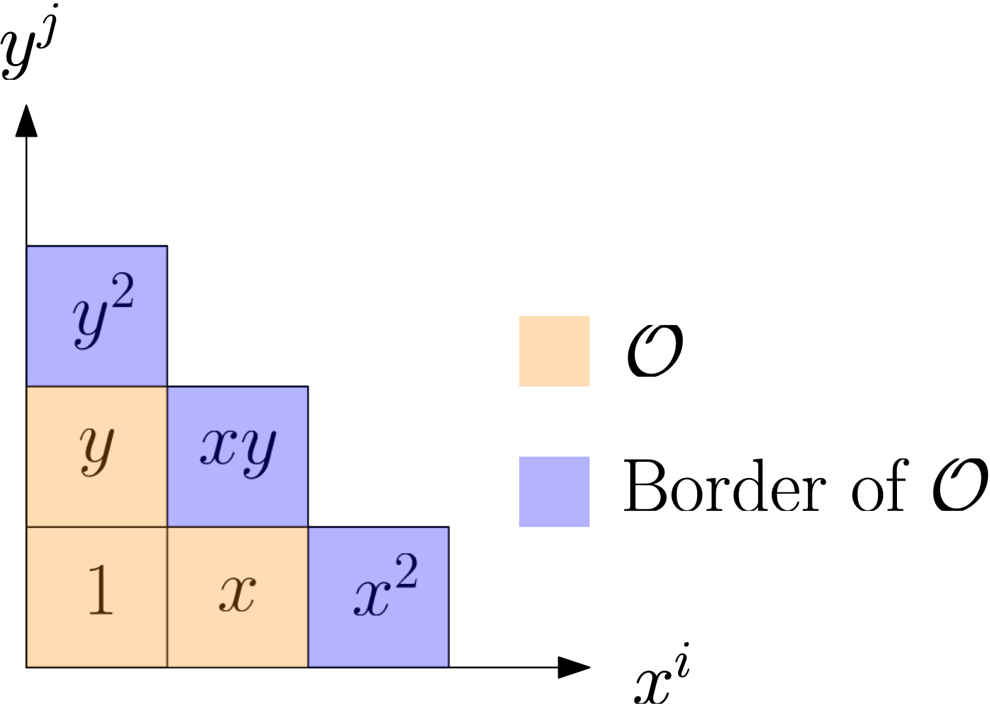
A first example of border bases
For $R=C[a,b,c,d,e,f,s,t,u][x,y]$, $O=\{1,x,y\}$
We say the ideal $I=⟨x^{2}-a-bx-cy,xy-d-ex-fy,y^{2}-s-tx-uy⟩$ is generated by an $O$-border basis, when the residue classes of $O=\{1,x,y\}$ form a basis for $R/I$. Here, the border of $O$ is the set $∂O=\{x^{2},xy,y^{2}\}$.
Why these names? Look at the diagram!
$M_{x}=\left(\begin{matrix}0 & a & d \\ 1 & b & e \\ 0 & c & f\end{matrix}\right)$ $M_{y}=\left(\begin{matrix}d & 0 & s \\ e & 0 & t \\ f & 1 & u\end{matrix}\right)$

Slide 9
Part II
Weyl algebras and border bases

Slide 10
The Weyl algebra
A polynomial ring of differential operators
The $n$-th Weyl algebra is given by $D_{n}=C[x_{1},…,x_{n}]⟨∂_{1},…,∂_{n}⟩$, and all the variables are pairwise commuting except for: $[∂_{i},x_{j}]=δ_{ij}$ .
Notation:
  We will always write operators with the derivatives at the very right, i.e. for$P=∂_{x}x-2=x∂_{x}-1$, we prefer the second form of this operator.
  We use $∙$ to denote the application of a differential operator on a function, e.g. $∂_{x}∙f=∂f/∂x$ .

Slide 11
The rational Weyl algebra
The $n$-th rational Weyl algebra is given by $R_{n}=C(x_{1},…,x_{n})⟨∂_{1},…,∂_{n}⟩$. It consists of differential operators with coefficients in the field of rational functions.
Both $D_{n}$ and $R_{n}$ are non-commutative rings. Due to this, we will consider left-ideals $I⊂D_{n}$ (resp. $J⊂R_{n}$ ). These are sets of differential operators closed under addition and left multiplication by any elements in $D_{n}$ (resp. $R_{n}$).
These ideals encode linear PDEs!
  For example, $J=⟨x∂-2⟩$ contains all the differential operators that annihilate $f(x)=x^{2}$. I.e. $[p(x∂-2)]∙f=0$, $∀p∈R_{1}$ .
  In the case of Feynman integrals $I$, the ideal $Ann(I)$ of all differential operators that annihilate $I$ is of particular interest.

Slide 12
Quotients of left-ideals
For $J⊂R_{n}$ left-ideals
${R_{n}}/J$ consists of equivalence classes, where $a∼b⟺a-b∈J$, and has a natural left-action by $R_{n}$. I.e., they are $R_{n}$-modules.
${R_{n}}/J$ has the structure of a $C(x_{1},…,x_{n})$-vector space. We write $rank(J)=\dim_{C(x_{1},…,x_{n})}R_{n}/J=m$. If $m∈N$, we say that $J$ has holonomic rank $m$.
  Example: $J=⟨∂_{x}^{2}+1,∂_{y}^{2}+1⟩∈R_{2}$ has holonomic rank 4. A convenient basis for ${R_{2}}/J$ is given by $O=\{1,∂_{x},∂_{y},∂_{x}∂_{y}\}$.
  Intuition: The holonomic rank $m$ will tell us the number of solutions to the linear PDE encoded by $J$.

Slide 13
Order ideals $O$
Encoding bases of ${R_{n}}/J$
Let $T^{n}$ be the set of monomials in partial derivatives $∂_{1},…,∂_{n}$, including 1, endowed with multiplication (e.g. $∂_{1}∂_{2}^{2}$ and $∂_{1}^{7}$ are monomials).
Definition: An order ideal $O$ is a subset of $T^{n}$ that contains 1, and that is closed under taking divisors. I.e., if $a∈O$ and $b|a$, then $b∈O$. We will be interested in finite order ideals, $|O|=m$ .
  Example: $O=\{1,∂_{x},∂_{y},∂_{x}∂_{y}\}$ is an order ideal. Note that because $∂_{x}∂_{y}∈O$, the other 3 elements also have to be there.
If$O$ is a basis of ${R_{n}}/J$, we can find matrices encoding the left-action of $∂_{i}$.

Slide 14
Method 1: Connection matrices
For $J⊂R_{n}$ with $rank(J)=m$ and $O$ a $C(x_{1},…,x_{n})$-basis of ${R_{n}}/J$
Let $O=\{t_{1},t_{2},…,t_{m}\}$. Without loss of generality, we can choose $t_{1}=1$.
Let $f∈Sol(J)$ be a generic solution of $J$. We can form a vector
$F=(f,t_{2}∙f,…,t_{m}∙f)^{⊤}$. This vector satisfies a 1st order linear PDE, called Pfaffian system:
$∂_{i}∙F=A_{i}F$ , for $i=1,…,n$.
The matrices $A_{i}∈{Mat}_{m×m}\left(C(x_{1},…,x_{n})\right)$ are called connection matrices. They satisfy the integrability conditions:
$[A_{i},A_{j}]=∂_{i}∙A_{j}-∂_{j}∙A_{i},$ for $i,j=1,…,n$.

Slide 15
Gauge transformations and connection matrices
For $J⊂R_{n}$ with $rank(J)=m$ and $O$ a $C(x_{1},…,x_{n})$-basis of ${R_{n}}/J$
If $\overset{˜}{F}=gF$, for $g∈{GL}_{m}\left(C(x_{1},…,x_{n})\right)$, then $\overset{˜}{F}$ satisfies a Pfaffian system:
$∂_{i}∙\overset{˜}{F}={\overset{˜}{A}}_{i}\overset{˜}{F}$ , for $i=1,…,n$,
The gauge-transformed matrices ${\overset{˜}{A}}_{i}$ are given by:
${\overset{˜}{A}}_{i}=gA_{i}g^{-1}+\frac{∂g}{∂x_{i}}g^{-1},$ for $i=1,…,n.$
Remark: The above transformation ensures that the ${\overset{˜}{A}}_{i}$ satisfy the integrability conditions.

Slide 16
Method 2: Multiplication matrices $M_{∂_{i}}$
For $J⊂R_{n}$ with $rank(J)=m$, and $O=\{t_{1},…,t_{m}\}$ a $C(x_{1},…,x_{n})$-basis of ${R_{n}}/J$
We can encode the of left-multiplication by $∂_{i}$ on ${R_{n}}/J$ by matrices $M_{∂_{i}}∈{Mat}_{m×m}\left(C(x_{1},…,x_{n})\right)$.
To obtain $M_{∂_{i}}$, note that we can write $∂_{i}t_{k}=\overset{l}{\underset{i=1}{∑}}c_{kl}^{(i)}[t_{l}]$, with $c_{kl}^{(i)}∈C(x_{1},…,x_{n})$. The $k$-th column of $M_{∂_{i}}$ is given by ${\left(c_{k1}^{(i)},c_{k2}^{(i)},…,c_{km}^{(i)}\right)}^{⊤}$.
These matrices satisfy the integrability conditions:
$[M_{∂_{i}},M_{∂_{j}}]=∂_{j}∙M_{i}-∂_{i}∙M_{j},$ for $i,j=1,…,n$.
Multiplication matrices related to connection matrices by a transpose:
$M_{∂_{i}}^{⊤}=A_{i}.$

Slide 17
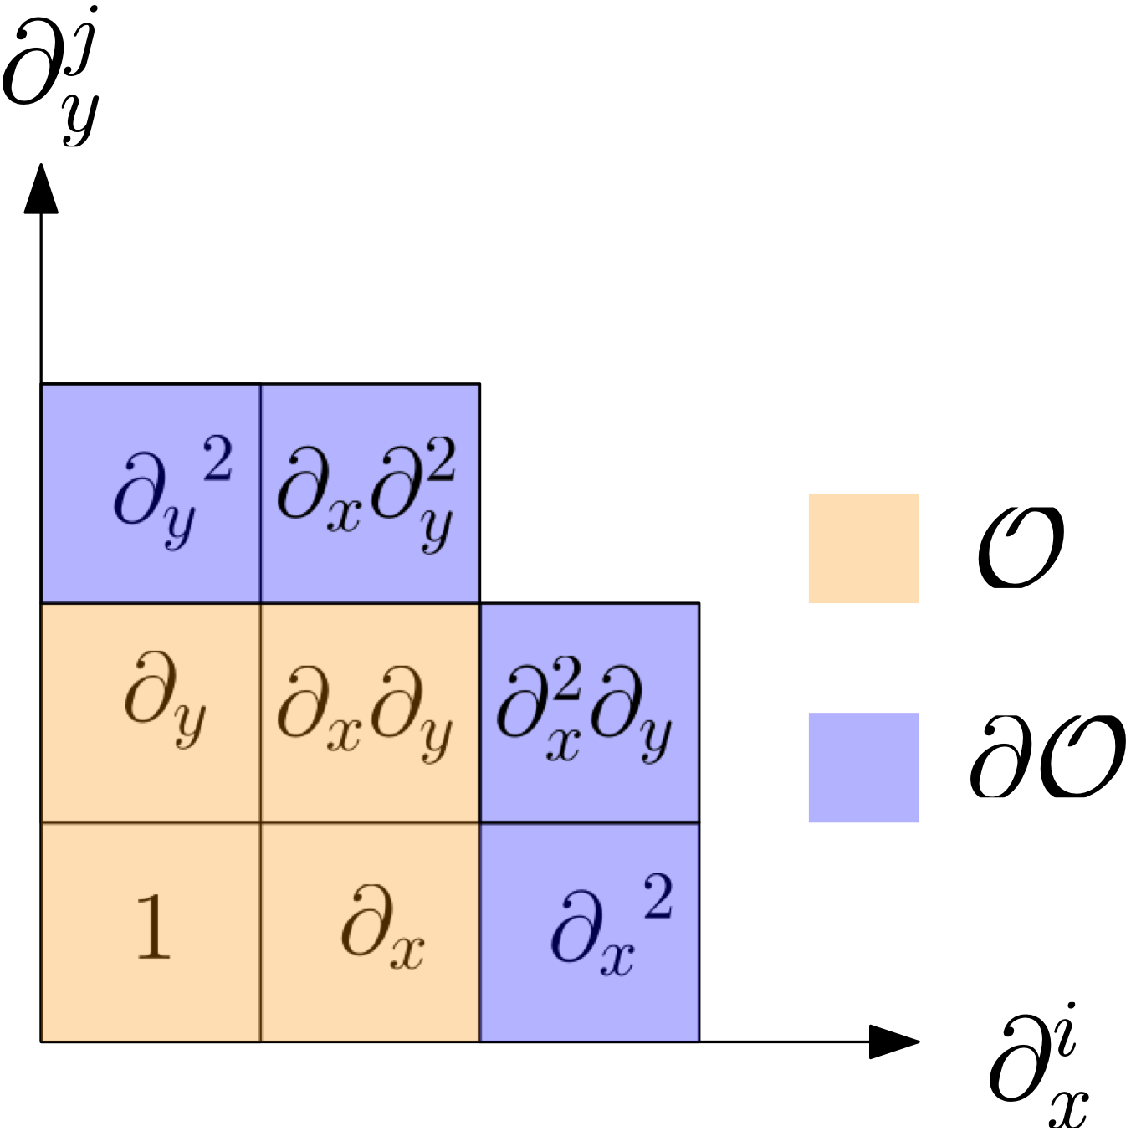
Order ideals and their borders
Definition: The border of $O$ is denoted by $∂O$, and is given by:
$∂O=\left(∪_{i=1}^{n}∂_{i}O\right)∖O$.
Intuition: In the 2-variable case, if an
order ideal contains a monomial $∂_{x}^{n}∂_{y}^{m}$, it
also contains all monomials to the left
of and below $∂_{x}^{n}∂_{y}^{m}$.
  Example: For $O=\{1,∂_{x},∂_{y},∂_{x}∂_{y}\},$
  the border is given by
  $∂O=\{∂_{x}^{2},∂_{x}^{2}∂_{y},∂_{x}∂_{y}^{2},∂_{y}^{2}\}$.

Slide 18
Border prebases in the rational Weyl algebra
For $O$ an order ideal
Let $O=\{t_{1},t_{2},…,t_{m}\}$ and $∂O=\{b_{1},b_{2},…,b_{p}\}$.
An $O$-border prebasis $G⊂R_{n}$ is of the form $G=\{g_{1},…,g_{p}\}$, where
$g_{i}=b_{i}-\overset{m}{\underset{j=1}{∑}}c_{i,j}t_{j},$
where $c_{i,j}∈C(x_{1},…,x_{n}).$
We can read off formal multiplication matrices $M_{∂_{i}}$ , $i=1,…,n$. These encode left-multiplication by $∂_{i}$ on ${R_{n}}/J$, where $J=⟨G⟩$, under the assumption that the residue classes of $O$ form a basis of ${R_{n}}/J$. The entries in $M_{∂_{i}}$ are either 0, 1 or some $c_{j,k}$.

Slide 19
Border bases in the rational Weyl algebra
For $O$ an order ideal with $|O|=m$ , $J⊂R_{n}$
Let $G⊂R_{n}$ be an $O$-border prebasis.
Definition: an $O$-border prebasis $G⊂J$ is an $O$-border basis if the residue classes of $O$ form a $C(x_{1},…,x_{n})$-basis of ${R_{n}}/J$.
  Remark. If $G⊂J$ is an $O$-border basis, it generates $J$. We write $J_{O}=⟨G⟩$.
Theorem (R, Sattelberger '25): An $O$-border prebasis $G$ is an $O$-border basis if, and only if, the formal multiplication matrices $M_{∂_{i}}$ satisfy the integrability conditions.

Slide 20
Part 3: The Sunrise integral

Slide 21
The Sunrise integral family
In dimension $d$
The unequal-mass Sunrise integrals belongs to the Feynman integral family $I_{ν_{1},ν_{2},ν_{3},ν_{4},ν_{5}}$ given by:
$I_{ν_{1},ν_{2},ν_{3},ν_{4},ν_{5}}=∫\overset{2}{\underset{j=1}{∏}}\frac{d^{d}k_{j}}{iπ^{d/2}}\frac{(k_{1}⋅p)^{-ν_{4}}(k_{2}⋅p)^{-ν_{5}}}{(k_{1}^{2}-m_{1}^{2})^{ν_{1}}(k_{2}^{2}-m_{2}^{2})^{ν_{2}}(p-k_{1}-k_{2})^{2}-m_{3}^{2})^{ν_{3}}}$ ,
where $ν_{i}∈Z$, $m_{i}∈C$, $p∈R^{1,3}$, and we integrate over the loop momenta $k_{j}∈R^{1,3}$.
We have $I_{ν_{1},…,ν_{5}}=I_{ν_{1},…,ν_{5}}(d;s,m_{1}^{2},m_{2}^{2},m_{3}^{2}).$

Slide 22
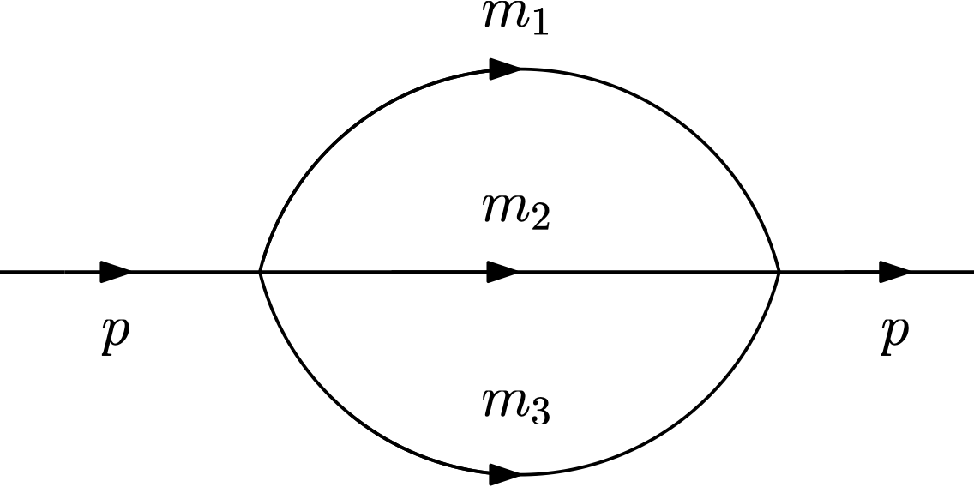
The Sunrise integral
In dimension $d$
The sunrise integral $I_{1,1,1,0,0}$ is the integral corresponding to the Feynman diagram:
For convenience, we will use the variables $\{x_{0},x_{1},x_{2},x_{3}\}=\{s,m_{1}^{2},m_{2}^{2},m_{3}^{2}\}$.
We will work over $R_{4}(d)=C(d)[x_{0},x_{1},x_{2},x_{3}]⟨∂_{0},∂_{1},∂_{2},∂_{3}⟩$.

Slide 23
A differential equation for the Sunrise integral
Following [Maggio, Sohnle, 2504.17757], the sunrise integral sits in a vector of 7 masters integrals:
$F=(I_{1,1,0,0,0},I_{1,0,1,0,0},I_{0,1,1,0,0},I_{1,1,1,0,0},I_{2,1,1,0,0},I_{1,2,1,0,0}.I_{1,1,2,0,0})^{⊤}$.
F=(I1,I2,I3,I4,I5,I6,I7)⊤.
The Pfaffian system is of the form
$∂_{i}∙F=A_{i}⋅F,$ for $i=0,1,2,3,$
where $A_{i}∈{Mat}_{7×7}\left(C(d,x_{0},x_{1},x_{2},x_{3})\right)$.

Slide 24
A change of basis for $F$
We now consider the following change of basis for $F$:
$\overset{˜}{F}=\left(\begin{matrix}I_{4} & \\ ∂_{1}∙I_{4} & \\ ∂_{2}∙I_{4} & \\ ∂_{3}∙I_{4} & \\ ∂_{1}∂_{3}∙I_{4} & \\ ∂_{2}∂_{3}∙I_{4} & \\ ∂_{3}^{2}∙I_{4} & \end{matrix}\right)=g_{\text{sunrise}}\left(\begin{matrix}I_{1} & \\ I_{2} & \\ I_{3} & \\ I_{4} & \\ I_{5} & \\ I_{6} & \\ I_{7} & \end{matrix}\right),$
where $g_{\text{sunrise}}∈{GL}_{7}\left(C(d)(x_{0},x_{1},x_{2},x_{3})\right)$.
Note that $O=\{1,∂_{1},∂_{2},∂_{3},∂_{1}∂_{3},∂_{2}∂_{3},∂_{3}^{2}\}$ here is an order ideal!

Slide 25
A gauge transform of the sunrise Pfaffian system
The new vector $\overset{˜}{F}$ satisfies a Pfaffian system:
$∂_{i}∙\overset{˜}{F}={\overset{˜}{A}}_{i}\overset{˜}{F},$ for $i=0,1,2,3$ .
Proposition: From the Pfaffian system above, we can read off an $O$-border prebasis $G$ of differential operators that annihilate the sunrise integral. Because this is an integrable connection, this is actually an $O$-border basis. We denote $J_{O}=⟨G⟩$.
We have that $rank(J_{O})=7$ .
That's it!

Slide 26
Some more details on $J_{O}=⟨G⟩$
$O=\{1,∂_{1},∂_{2},∂_{3},∂_{1}∂_{3},∂_{2}∂_{3},∂_{3}^{2}\}$, and $∂O=\{∂_{0},∂_{0}∂_{1},…,∂_{3}^{3}\}$, with $|∂O|=16$ .
Example: The 1st row of ${\overset{˜}{A}}_{0}$ is
$\left(\frac{d-3}{x_{0}},-\frac{x_{1}}{x_{0}},-\frac{x_{2}}{x_{0}},-\frac{x_{3}}{x_{0}},0,0,0\right),$
from which we read off
$b_{1}=∂_{0}-\frac{d-3}{x_{0}}+\frac{x_{1}}{x_{0}}∂_{1}+\frac{x_{2}}{x_{0}}∂_{2}+\frac{x_{3}}{x_{0}}∂_{3}.$
The ideal $J_{O}$ coincides with the one described in a recent work of Flieger [Fleiger, 2508.04309] for banana integrals.

Slide 27
Concluding remarks
We have Mathematica notebooks available describing all the computations presented here!
Border bases in the rational Weyl algebra allow us to go from Pfaffian systems (differential equations) to $R_{n}$-ideals. This complements tools such as Macaulay Matrices [Chestnov et al., 2204.12983] or the ConnectionMatrices package in Macaulay2 [Görlach et al, 2504.01362], which compute Pfaffian systems from $D_{n}$-ideals.
Border bases give new tools to characterize ideals $J∈R_{n}$ of finite holonomic rank.
Moreover, we can use tools such as LiteRed [Lee, Roman N.,1310.1145], which compute differential equations of Feynman integrals to study their annihilating ideals.

Slide 28
Annotated Bibliography
Chestnov, Vsevolod, Gasparotto, Federico, Mandal, Manoj K., Mastrolia, Pierpaolo, Matsubara-Heo, Saiei J., Munch,Henrik J., Takayama, Nobuki. Macaulay Matrix for Feynman Integrals: Linear Relations and Intersection Numbers. J. High Energ. Phys. 2022, 187 (2022). arXiv:2204.12983. Here, the authors describe a method to obtain Pfaffian systems from $D_{n}$-ideals of finite holonomic rank.
Flieger, Wojciech. D-ideal of generic mass banana integrals in dimensional regularization. arXiv:2508.04309. Here, the author describes operators that annihilate the generic-mass banana integrals in dim. reg., and conjectures that they always generate the annihilating operators of the expected holonomic rank.
Görlach, Paul, Koefler, Joris,Sattelberger, Anna-Laura, Sayrafi, Mahrud, Schroeder, Hendrik, Weiss, Nicolas, and Zaffalon, Francesca. Connection Matrices in Macaulay2. arXiv:2504.01362. Here, the authors describe a Macaulay2 package implementation to obtain Pfaffian systems from $D_{n}$-ideals of finite holonomic rank.
Kehrein, Achim and Kreuzer, Martin and Robbiano, Lorenzo, An algebraist’s view on border bases. Chapter 4 of the book Solving Polynomial Equations: Foundations, Algorithms, and Applications. 2005. Detailed explanation of Border bases in the commutative case.
Lee, Roman N. LiteRed 1.4: a powerful tool for the reduction of the multiloop integrals. Journal of Physics: Conference Series 523 (2014) 012059. arXiv:1310.1145. Where would we be without LiteRed? This software was used to obtain the Pfaffian system of the Sunrise integrals.
Maggio, Sara and Sohnle, Yoann. On canonical differential equations for Calabi-Yau multi-scale Feynman integrals. arXiv:2504.17757. They write in detail properties of the basis of the unequal mass sunrise, and shared the differential equations with us! They used LiteRed to obtain the matrices.

Slide 29
Thanks for your attention!
Feel free to ask more questions
I'm on the postdoc market this year. If you're interested, let me know :)
See more in: pilk.love/carlos

